Slide 1
Senior Affairs Point of Sale System Memberships Training Course
Self-Paced Course
Course Introduction, Overview and Definitions
Revised December 6, 2016

Slide 2
DSA Memberships Course Introduction Overview and Definitions
After completing this course, you shall be able to:
Issue and renew memberships and process payment transactions in the point of sales system for the Department of Senior Affairs in accordance with policies, rules, regulations and legislation.

Slide 3
DSA Memberships Course Introduction Overview and Definitions
Course Goals/Objectives:
Understand the City’s Policies, Rules and Regulations for Department of Senior Affairs (DSA) Memberships
Understand the role of the Area Agency on Aging (AAA)
Understand Membership Cards vs. Membership Passes
Understand Membership Card Eligibility and Benefits
Understand Aggregate Cards and Aggregate Card Use
Understand Siriusware and SAMS applications systems and their purposes

Slide 4
DSA Memberships Course Introduction Overview and Definitions
Once you have completed this full course you shall
know how to:
Issue a new membership pass and process a payment transaction
Renew a membership pass and process a payment transaction
Process a membership card, reprint and process a payment transaction
Identify AAA eligibility exceptions
Create a membership based on AAA eligibility exceptions
Track and process AAA meal transactions in Siriusware through the Special Codes

Slide 5
DSA Memberships Course Introduction Overview and Definitions
Overview of full Course Content:
Section 1- Siriusware & SAMS systems
Section 2 – Memberships Overview/Memberships & Passes
Section 3 – Issuing a New Membership Card
Section 4 – Renewing a DSA Membership
Section 5 – Print/Reprint-Lost/Stolen/Request for New Card/Forgotten Card
Section 6 – Alternate DSA Membership Eligibility/Linking in Point of Sale System-Special Codes
Section 7 – Alternate Meal and Membership Eligibility/Special Codes (For meal sites only)
Section 8 – Aggregate Cards and Special Reporting Codes in DSA Point of Sale System (For meal sites only)

Slide 6
DSA Memberships Course Introduction Overview and Definitions
Overview of this course section:
Please review the following content, terms and definitions prior to beginning the topics. This section of the course will help you get familiar with common terms and their meanings as they are used within processes throughout this course.
The Department of Senior Affairs staff is responsible for issuing memberships at DSA locations for the citizens of the City of Albuquerque. It is imperative for DSA staff to understand the City of Albuquerque and AAA Rules, Policies and procedures and legislation that govern this process.
Upon completion of this course you shall have the tools and information to successfully complete your duties as a Department of Senior Affairs employee to issue new and renewal membership cards/passes in the Siriusware system.

Slide 7
DSA Memberships Course Introduction Overview and Definitions
Department of Senior Affairs (DSA): Department of Senior Affairs is a community leader, who, in partnership with others, involves seniors and people of all ages in creating a community that enhances everyone’s quality of life by providing opportunities to achieve their potential, share their wisdom, maintain their independence, and live in dignity.

Slide 8
DSA Memberships Course Introduction Overview and Definitions
Area Agency on Aging (AAA):
The City of Albuquerque and Bernalillo County Area Agency on Aging (AAA) is a state-sanctioned and federally mandated entity tasked with developing a comprehensive needs assessment, program planning and implementation and monitoring of all services to people over the age of 60, in Albuquerque and Bernalillo County. Lunches at meal sites and other activities are reimbursable and tracked by DSA for qualified 60 + seniors.

Slide 9
DSA Memberships Course Introduction Overview and Definitions
What is the Social Assistance Management System (SAMS)?
SAMS is the Reporting System for Qualifying Services for the Area Agency on Aging Activities. Member information, meals, activities and other items are tracked in SAMS for federal reporting and funding requirements for 60+ members who have filled out a SAMS form and have been entered into the SAMS system.
What is an Area Agency on Aging (AAA) Qualifying Service?:
Qualifying services are determined by the case review of each 60+ member and their qualifying circumstances through the DSA member case management review process. Certain services are funded by AAA.
What is Siriusware?
Point of Sales System of record. (DSA and the Parks and Recreation Department use this system.)
What is a Point of Sale system?
A point of sale (POS) is the place where sales are made. A point of sale system is a combination of software and hardware that allows us to make financial transactions and simplify key day-to-day business operations.

Slide 10
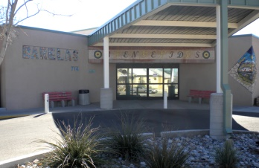
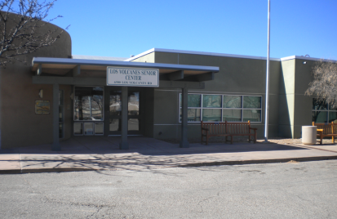
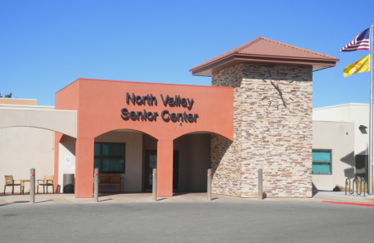
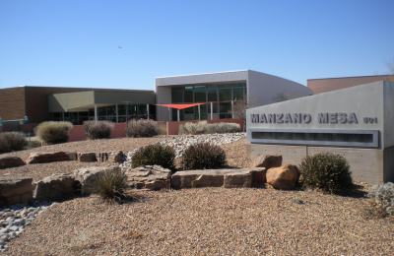
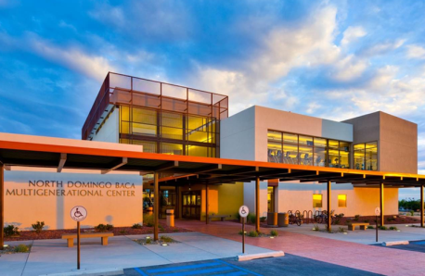
DSA Memberships Course-Introduction Overview and Definitions
DSA Meal Site: Every lunch meal at a meal site must be accounted for in the Siriusware and SAMS systems. DSA Meal Sites are listed below:
Senior Centers:
Barelas Senior Center
North Valley Senior Center
Los Volcanes Senior Center
Multigenerational Centers:
Manzano Mesa Multigenerational Center
North Domingo Baca Multigenerational Center

Slide 11
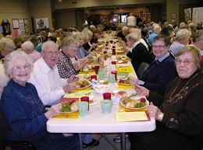
DSA Memberships Course-Introduction Overview and Definitions
Congregate Meals: Lunch meals for qualified seniors reimbursable by AAA to the Department of Senior Affairs.

Slide 12
DSA Memberships Course-Introduction Overview and Definitions
Special Codes-for AAA Eligibility Exceptions: Codes in Siriusware under the “Special” button on the Point of Sale screen to track AAA eligibility exceptions for meal reimbursement reports to the Area Agency on Aging (AAA). (See Section 7 – Alternate Meal and membership Eligibility/Special Codes)
Scenario | Alternate Membership Eligibility/System Meal Special Code | Membership Card Color/Benefits
Spouse under 60 years of age | Eligible for lunch on a donation basis-needs to fill out a SAMS form and be entered into the SAMS system. (32AGSpouse) | Same card banner age eligibility color as qualified senior. Eligible for Title III congregate meal. A spouse under 60 is also eligible to participate in Activities/Trips, etc. with qualified senior present.
Disabled child living with qualified senior 60+ | Eligible for lunch on a donation basis - needs to fill out SAMS form and enter into the SAMS system. (32AGDISWE) | Same card banner age eligibility color as qualified senior. Eligible for Title III congregate meal. A disabled child under 60 living with a qualified senior is also eligible to participate in Activities/Trips, etc. with qualified senior present.

Slide 13
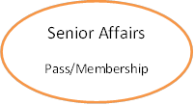
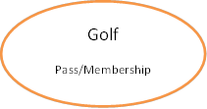
DSA Memberships Course Introduction Overview and Definitions
City of Albuquerque Membership Account: Each person should only have one City of Albuquerque Member Account with their contact information and picture in the point of sales system.
This membership account can be started at any of the participating department locations if they are obtaining a membership card for that department. A person may have several different Membership Cards/Passes if they are members of Senior Affairs, Aquatics or Golf.
DSA Membership cards can be purchased at any of the six senior centers or two multigenerational centers.
Department Membership Card: Senior Affairs/Golf Membership Card
Each Dept./Division (Senior Affairs and Golf) have their own:
Membership Cards/Passes
Membership
Membership Card
Membership Card
Notes:
Scenario: If Bob Lopez goes to a Golf center and gets a new membership, an account is created in the Siriusware system. Bob pays and is issued a Golf membership pass. Bob can also go to a Senior Center, the Senior Center personnel should do a guest lookup to see if Bob is in the system. Because Bob opened a membership at a golf center, he is in the system. The Senior Center staff can now issue Bob Lopez a Senior Affairs Membership based on his eligibility and is issued a Membership card from the senior Center. Bob now has two passes, one for Golf and one for Senior affairs, holds specific pass/membership cards for each, but only has one account in the Siriusware system.

Slide 14
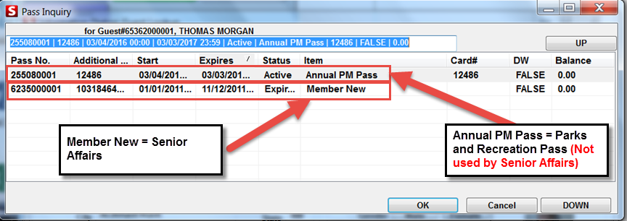
DSA Memberships Course Introduction Overview and Definitions
Pass#
A pass number is created when a pass is sold for use or access by the holder of the Membership. Each pass has a unique number and the number never changes.
Since both Parks and Senior Affairs utilize the point of sales system there are different passes.
Member New = Senior Affairs
Annual PM Pass = Parks & Recreation Department (Not used by Senior Affairs)

Slide 15
DSA Memberships Course Introduction Overview and Definitions
Membership/Pass Categories:
Department | Category | Item
32SENIOR | MEMBERSHIP | 18-49 NEW
32SENIOR | MEMBERSHIP | 18-49 REN
32SENIOR | MEMBERSHIP | 50-59 NEW
32SENIOR | MEMBERSHIP | 50-59 REN
32SENIOR | MEMBERSHIP | 60PLUS REN
32SENIOR | MEMBERSHIP | 60 PLUSNEW
32SENIOR | MEMBERSHIP | BOOMER NEW
32SENIOR | MEMBERSHIP | BOOMER REN
32SENIOR | MEMBERSHIP | MEMBER 18+
32SENIOR | MEMBERSHIP | MEMBER -18
32SENIOR | MEMBERSHIP | MEMBER NEW
32SENIOR | MEMBERSHIP | MEMBER REN
32SENIOR | MEMBERSHIP | ONLINEPASS
32SENIOR | MEMBERSHIP | REVONLINE
32SENIOR | MEMBERSHIP | SPRAYPARK

Slide 16
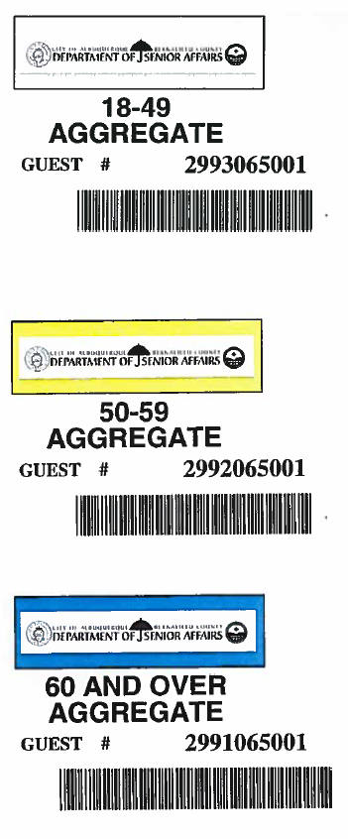
DSA Memberships Course Introduction Overview and Definitions
DSA Memberships: DSA memberships are $13.00 annually
DSA membership card issuance and benefits are regulated by the Department of Senior Affairs by age class:
18-49: White Membership Card
50-59: Yellow Membership Card
60 +: Blue Membership Card
There are special exceptions when a citizen qualifies for a DSA membership
*(See Section 7 of this course to learn more about Alternate Meal and Membership Eligibility/Special Codes)

Slide 17
DSA Memberships Course Introduction Overview and Definitions
Membership Policies & Procedures-DSA Employee Role: The Department of Senior Affairs staff is responsible for issuing memberships at DSA locations for the citizens of the City of Albuquerque. It is necessary for DSA staff to understand the City of Albuquerque and AAA rules, policies, procedures and legislation that govern this process.

Slide 18
DSA Memberships Course Introduction Overview and Definitions
Membership Card Benefits: Citizens in Albuquerque can obtain a membership with the Department of Senior Affairs affording them certain benefits such as the ability to participate in trips, activities, dances, meals, exercise and space based on their age group and eligibility.
Membership Expiration: DSA membership Cards expire one year from the date of issuance.

Slide 19
DSA Memberships Course Introduction Overview and Definitions
DSA Membership Card:
Issuance: A membership card is issued through the Siriusware system by DSA staff.
Member Picture: DSA Members are required to have their picture on their membership card.
Membership Card Information: The DSA membership card has the member’s first and last name, guest number, age eligibility color class (White 18-49, Yellow 50-59, Blue 60+), member picture, a bar code on the front (for the SAMS system) and a magnetic stripe on the back for Siriusware transactions.
Expiration Date/Label: Each membership card also has an expiration label on the back that is applied by DSA staff when they are issuing or renewing a membership card.
Membership Card Requirements: Members are required to present their membership card for transactions when participating in any activities or eating at any DSA site.

Slide 20
DSA Memberships Course Introduction Overview and Definitions
Aggregate Cards: Aggregate Cards are to only be used to process a congregate meal lunch for a guest or a person who’s SAMs application has not yet been entered into the SAMs database.
Specific age eligibility (White 18-49, Yellow 50-59, Blue 60+) aggregate cards will be kept at the front desk of each Senior Center. DSA staff are the holders of these cards.

Slide 21
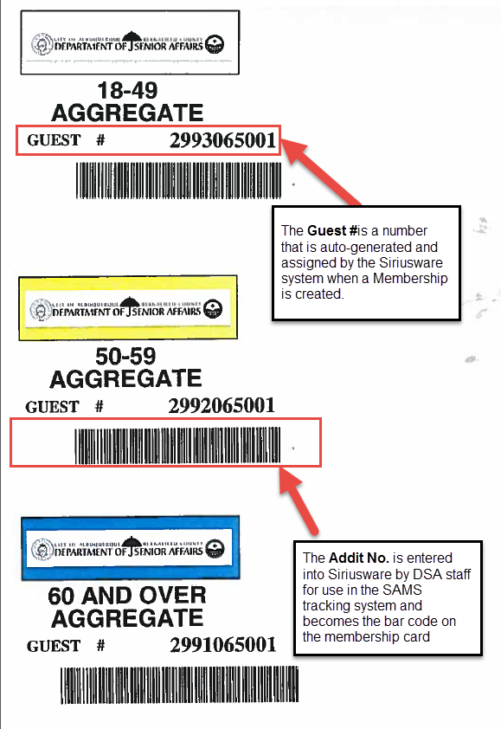
DSA Memberships Course Introduction Overview and Definitions
Guest #:
The guest number is assigned when a City of Albuquerque Membership is created for a person in the Siriusware system.
Addit No.: The Addit No. is the reference number that the SAMS system uses from the Senior Affairs membership setup.
The Addit No. allows for the card to be used on both the Siriusware point of sales system and the SAMS system for tracking meals and reimbursements.
The Addit No. is entered into the Siriusware system by DSA staff when a new membership card is issued.
An Addit No. can be added, modified or deleted by anyone with the corresponding security
The Addit No. is represented on the front of the membership card as a bar code.

Slide 22
Quick Reference Guide to Course Content
Department of Senior Affairs (DSA)
Social Assistance Management System (SAMS)
Area Agency on Aging (AAA)
Siriusware
City of Albuquerque Membership Account
Membership Card
Pass Number (Pass No.)
Membership Policies & Procedures-DSA Employee Role
Membership Card Benefits
Membership Expiration
DSA Memberships
Membership/Pass Categories
Membership Card Benefits
Membership Expiration
Membership Card Issuance
Membership Card Picture
Membership Card Information
Membership Card Expiration Date/Label
Membership Card Requirements
Aggregate Card
Guest #
Addit No.

Slide 23
DSA Memberships Course Introduction Overview and Definitions
Congratulations! You have completed the Introduction Overview and Definitions section for the DSA Memberships Course

